Slide 1

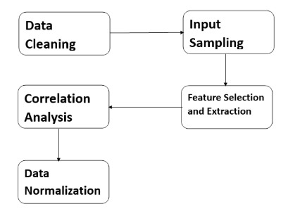
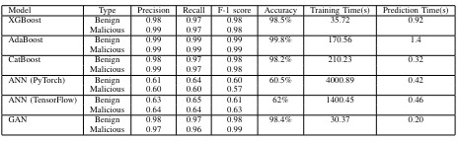
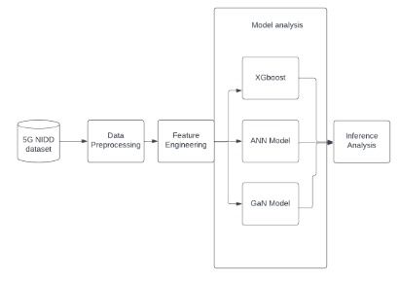
5G-NIDD: A Comprehensive Analysis of Network Intrusion Detection Algorithms on 5G Wireless Network Dataset
Adit Sandeep Virkar*, Arnav Raviraj*, Shivanjay Vilas Wagh*, and Vinay Kantilal Chavhan*
Masters in Software Engineering, Arizona State University, Tempe, AZ
Abstract
Data Processing
Results
This study investigates the escalating security challenges and vulnerabilities presented by the advancement of fifth-generation (5G) wireless networks. As these networks enhance connectivity, data rates, and device integration, they also introduce sophisticated threats due to their complex infrastructure and the integration of artificial intelligence (AI) and machine learning (ML). This research emphasizes the necessity of robust, comprehensive datasets like 5G-NIDD (5G Network Intrusion Detection Dataset) to effectively deploy AI and ML solutions for proactive threat detection and mitigation. By examining eight significant papers, this paper explores various facets of network security, from developing intrusion detection systems to applying AI for enhanced security protocols and exploring novel security challenges within 5G frameworks. The outcomes underscore the critical role of AI and ML in addressing modern network security challenges and set a foundation for future research and security measures in the rapidly evolving landscape of wireless technologies.
The data preprocessing stage for the 5G Network Intrusion Detection Dataset (5G-NIDD) involved removing null values and converting categorical data into numerical characters using one-hot encoding. Feature selection was performed using Pearson and Spearman correlation coefficients to identify highly correlated features, and Random Forest algorithm was used to extract the top 10, 15, and 25 features based on their importance scores. Data normalization was achieved through Min-Max scaling to standardize input variables, optimizing the performance and effectiveness of machine learning algorithms. The 5G-NIDD datasets hosted on the SER\_517\_F\_33 GitHub repository provide comprehensive resources for analyzing Network-Initiated Dedicated Device performance within 5G networks, facilitating advanced analysis and predictive modeling. Subsequent analysis involved using various machine learning models, including deep neural networks, with a comparative evaluation of their performance for binary classification tasks.
Flow Diagram for Data Processing Techniques
Boosting and GAN-based model performed well, and ANN-based models didn’t perform as expected.
Machine Learning Models
Conclusion
Introduction
The advancements in 5G and the emerging 6G technologies offer improved connectivity but also pose challenges for network security due to the expanded attack surface and increased use of AI and ML. This paper analyzes the state of network security research in the context of 5G, emphasizing the importance of datasets like 5G-NIDD for effective threat detection. Our evaluation of machine learning algorithms, including boosting models and neural networks, highlights their performance and applicability in network security tasks. Boosting models show superior accuracy and efficiency, underscoring their potential for safeguarding future wireless networks against cyber threats. Continued innovation and collaboration in this field are crucial for developing proactive security solutions that keep pace with evolving wireless technologies.
The evolution of fifth-generation (5G) and the inception of sixth-generation (6G) technologies have significantly increased the complexity of network infrastructures, offered unprecedented connectivity and data rates while introduced new security challenges. Integrating artificial intelligence (AI) and machine learning (ML) in network security holds promise for proactive threat detection but requires robust datasets reflecting modern network dynamics. To address this, we introduce 5G-NIDD, a dataset crafted from real-world 5G flows, enhancing intrusion detection research and providing a rich resource for testing novel algorithms.
This paper evaluates the efficacy of 5G-NIDD and aims to bridge the gap between theoretical research and practical application in AI-based security for future wireless communication infrastructures, particularly within the realms of beyond 5G (B5G) and 6G networks. By leveraging authentic datasets and advanced ML techniques, this endeavor seeks to fortify the foundations of future network security against sophisticated threats in intelligent and interconnected environments. Through comprehensive evaluations using diverse ML techniques, we demonstrate the utility of 5G-NIDD in advancing the state-of-the-art in intrusion detection within dynamic 5G network environments. The culmination of these efforts not only addresses the dearth of authentic datasets but also provides a steppingstone towards innovative security mechanisms capable of safeguarding the integrity and confidentiality of future wireless networks.
Future Scope
Workflow of Machine Learning Models.
Considering the growing use of deep learning and neural network models, the threat of adversarial attacks poses significant challenges to their reliability and safety. Adversarial attacks exploit vulnerabilities by subtly altering input data to deceive networks into making incorrect predictions, endangering high-stakes applications like autonomous vehicles and medical diagnostics. While boosting models are less susceptible to such attacks, future work must focus on creating more resilient architectures and defense mechanisms for neural networks. This includes exploring advanced adversarial training techniques, real-time detection of adversarial inputs, and collaboration across research communities to develop standardized evaluation frameworks. Enhancing the robustness of both neural networks and boosting models is crucial for ensuring their effectiveness and trustworthiness in diverse applications
This section provides a detailed analysis of the dataset using various boosting algorithms, including XGBoost, AdaBoost, and CatBoost, along with artificial neural networks (ANN) and generative adversarial networks (GAN). The boosting algorithms are employed for classification tasks, while the ANN models are utilized for data modeling with rectified linear unit (ReLU) activation functions and Adam optimizer. GANs are utilized to generate synthetic 5G network data, including attacks, with a discriminator-generator architecture trained simultaneously in an adversarial manner. Synthetic data generated by the GAN is then combined with the original dataset for downstream classification tasks, providing insights into the effectiveness of GAN-generated data for enhancing machine learning model performance.
Acknowledgement
This is to acknowledge our sponsor Dr. Abdullah Moubayed for his generous support and invaluable contributions throughout the duration of our project. His experience and insights played a pivotal role in completion of our research based on 5G-NIDD intrusion detection-based system.

